Slide 1
Revision and Preparation and Guideline for Assessment 3
Week 12
Dr. Farshid Keivanian

Slide 2
Assessment 3: From Network Design to Troubleshooting
Apply networking knowledge to realistic workplace problems.
Diagnose and correct faults in an existing network.
Design and configure a network for two departments.
Test connectivity, security and remote access.
Explain your work through a technical report, presentation and viva.
3
Presentation_ID
© 2008 Cisco Systems, Inc. All rights reserved.

Slide 3
Assessment 3: From Network Design to Troubleshooting
Australian example: A junior network engineer working for a Sydney IT services company may be asked to investigate a network outage and set up connectivity for a new office.
Discussion: Why is a working Packet Tracer network not enough on its own?
Answer: A network engineer must also explain the design, prove that it works and document how problems were resolved.
3
Presentation_ID
© 2008 Cisco Systems, Inc. All rights reserved.

Slide 4
Assessment Structure and Marking
Assessment component | Marks
Scenario 1 – Troubleshooting and diagnosis | 16
Scenario 2 – Network architecture and IPv4 design | 10
Scenario 2 – Configuration, security and testing | 12
Technical analysis and design justification | 5
Technical report, presentation and viva | 7
Total | 50
3
Presentation_ID
© 2008 Cisco Systems, Inc. All rights reserved.

Slide 5
Assessment Structure and Marking
The rubric assesses both practical implementation and technical understanding.
Students should review all five criteria before beginning.
Evidence should correspond to the actual submitted Packet Tracer files.
Discussion: Can a student achieve the highest marks by submitting only screenshots of a working network?
Answer: No. The rubric also requires accurate explanations, diagnostic reasoning, design justification, professional documentation and viva performance.
3
Presentation_ID
© 2008 Cisco Systems, Inc. All rights reserved.

Slide 6
What Skills Will You Develop?
Network design: choosing devices and planning connections.
IP addressing: configuring subnets and default gateways.
Cisco IOS: configuring and checking routers and switches.
Troubleshooting: identifying faults and testing solutions.
Network security: protecting devices and configuring remote access.
Technical communication: reporting and explaining your decisions.
3
Presentation_ID
© 2008 Cisco Systems, Inc. All rights reserved.

Slide 7
What Skills Will You Develop?
Australian example: These skills are useful in IT support teams, managed service providers, universities and corporate networks across Australia.
Discussion: Which skill is most important when a user reports that the network has stopped working?
Answer: Troubleshooting, supported by knowledge of addressing, routing, devices and network protocols.
3
Presentation_ID
© 2008 Cisco Systems, Inc. All rights reserved.

Slide 8
Career Opportunities in Australia
Students can explore entry-level and developing career opportunities such as:
Job title | Relevant assessment skills
IT Support Officer | Connectivity testing and fault diagnosis
Service Desk Analyst | Troubleshooting and technical communication
Network Support Technician | Switches, routers and IP configuration
Junior Network Administrator | Network maintenance and documentation
Network Operations Centre (NOC) Analyst | Monitoring and incident investigation
Junior Network Engineer | Network design, routing and security
3
Presentation_ID
© 2008 Cisco Systems, Inc. All rights reserved.

Slide 9
Career Opportunities in Australia
Search on SEEK Australia or LinkedIn Jobs using terms such as Junior Network Engineer, Network Support, NOC Analyst and Cisco Networking.
Discussion: Which job would benefit most from knowing how to use show ip route?
Answer: Network support, network administration and NOC roles, because they frequently investigate routing and connectivity problems.
3
Presentation_ID
© 2008 Cisco Systems, Inc. All rights reserved.

Slide 10
Understand the Two Assessment Scenarios
Scenario 1 – Troubleshooting
Investigate an existing Packet Tracer network.
Complete four troubleshooting/information-gathering tickets.
Use permitted Cisco IOS commands.
Identify faults and provide corrective commands where applicable.
Answer route and round-trip-time questions.
3
Presentation_ID
© 2008 Cisco Systems, Inc. All rights reserved.

Slide 11
Understand the Two Assessment Scenarios
Scenario 2 – Network design
Redesign the ABC company network.
Connect HR and Finance through a shared ISP connection.
Plan for future devices.
Configure and verify the required network services.
Provide technical evidence and design justification.
3
Presentation_ID
© 2008 Cisco Systems, Inc. All rights reserved.

Slide 12
Understand the Two Assessment Scenarios
Discussion: What is the main difference between the scenarios?
Answer: Scenario 1 focuses on diagnosing an existing network; Scenario 2 focuses on designing and implementing a network to meet business requirements.
3
Presentation_ID
© 2008 Cisco Systems, Inc. All rights reserved.

Slide 13
Read the Network Topology Before Configuring
Identify:
Routers and switches.
PCs, servers and other end devices.
LAN and WAN connections.
Interface names and IP addresses.
Default gateways and routing paths.
Existing connections and possible points of failure.
3
Presentation_ID
© 2008 Cisco Systems, Inc. All rights reserved.

Slide 14
Read the Network Topology Before Configuring
Australian example: Before changing a network in a Melbourne office, a technician reviews the network diagram to avoid disconnecting the wrong department.
Discussion: Why should you inspect the topology before entering Cisco commands?
Answer: To understand how devices connect and avoid making changes to the wrong interface or device.
3
Presentation_ID
© 2008 Cisco Systems, Inc. All rights reserved.

Slide 15
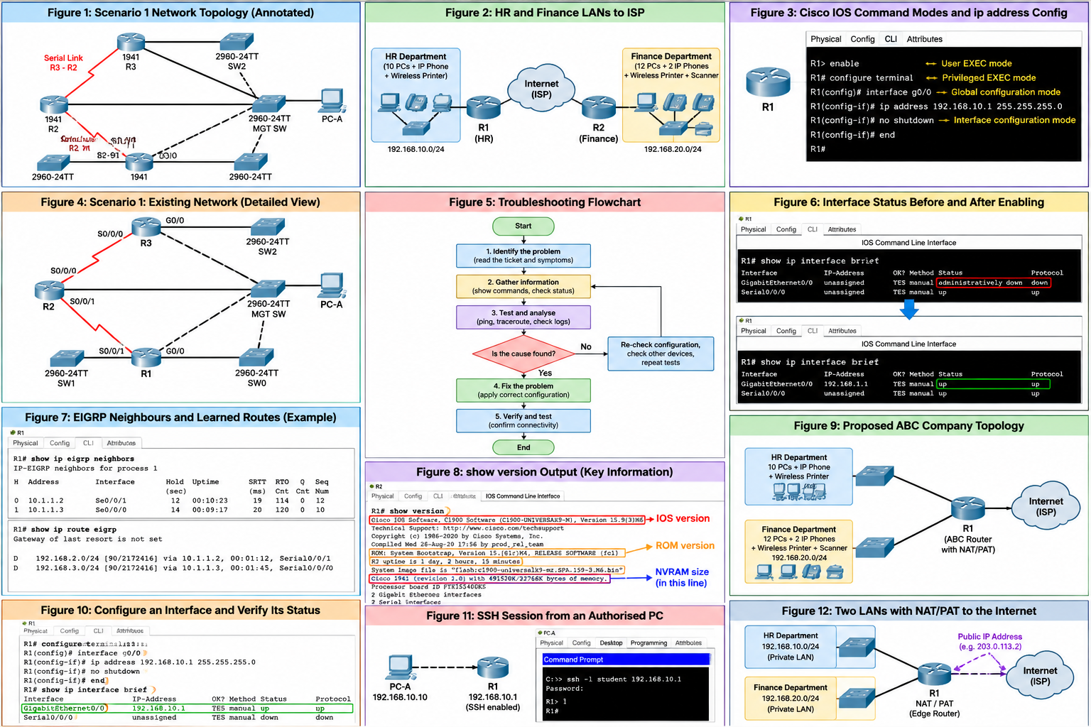
Read the Network Topology Before Configuring
This diagram shows how routers, switches and computers are connected in Scenario 1. The red lines represent serial connections between routers, while the black lines show Ethernet connections.
3
Presentation_ID
© 2008 Cisco Systems, Inc. All rights reserved.

Slide 16
Essential IPv4 Addressing Knowledge
An IPv4 address identifies a network interface.
A subnet mask identifies the network and host portions.
Devices in the same subnet can normally communicate directly through a switch.
Devices in different subnets need routing.
A default gateway is used to reach destinations outside the local subnet.
3
Presentation_ID
© 2008 Cisco Systems, Inc. All rights reserved.

Slide 17
Essential IPv4 Addressing Knowledge
Example
Device | IP address | Mask | Gateway
PC-A | 192.168.1.10 | 255.255.255.0 | 192.168.1.1
PC-B | 192.168.2.10 | 255.255.255.0 | 192.168.2.1
Discussion: Can these two PCs communicate through switches alone?
Answer: Not under normal Layer 2 switching. A router or Layer 3 switch is needed between their different IP subnets.
3
Presentation_ID
© 2008 Cisco Systems, Inc. All rights reserved.

Slide 18
Subnetting and Future Network Growth
Calculate how many IP-enabled devices each department requires.
Include network infrastructure interfaces and future expansion.
Select a suitable subnet size.
Avoid overlapping subnet ranges.
Document the addressing scheme.
3
Presentation_ID
© 2008 Cisco Systems, Inc. All rights reserved.

Slide 19
Subnetting and Future Network Growth
Illustrative planning example
Department | Current end devices | Example subnet
HR | 12 | 192.168.10.0/27
Finance | 16 | 192.168.20.0/27
Both /27 networks provide 30 usable IPv4 addresses. These are teaching examples, not prescribed assessment addresses.
Discussion: Why might a /28 subnet be unsuitable for Finance?
Answer: It provides only 14 usable addresses, which is fewer than Finance's 16 listed end devices, even before allowing for a gateway or future growth.
3
Presentation_ID
© 2008 Cisco Systems, Inc. All rights reserved.

Slide 20
Switches, Routers and Internet Connectivity
Switches connect devices within a local network.
Routers connect different IP networks.
A default gateway forwards traffic outside the local subnet.
An ISP connection provides a route towards the Internet.
NAT/PAT may allow multiple private IPv4 devices to share a public IPv4 address.
3
Presentation_ID
© 2008 Cisco Systems, Inc. All rights reserved.

Slide 21
Switches, Routers and Internet Connectivity
Australian example: A small Sydney business may connect its HR and Finance networks to one business Internet service.
Discussion: Does connecting a router to an ISP automatically give every PC Internet access?
Answer: No. Correct addressing, gateways, routing, ISP connectivity and often NAT and DNS are also required.
3
Presentation_ID
© 2008 Cisco Systems, Inc. All rights reserved.

Slide 22
Switches, Routers and Internet Connectivity
This diagram shows how the HR and Finance departments connect to the Internet through their network devices. Both departments can access the Internet while using separate local networks.
3
Presentation_ID
© 2008 Cisco Systems, Inc. All rights reserved.

Slide 23
Cisco IOS Command Modes
Mode | Example prompt | Purpose
User EXEC | Router> | Basic monitoring
Privileged EXEC | Router# | Advanced monitoring
Global configuration | Router(config)# | Device-wide configuration
Interface configuration | Router(config-if)# | Interface settings
3
Presentation_ID
© 2008 Cisco Systems, Inc. All rights reserved.

Slide 24
Cisco IOS Command Modes
Example commands:
enable
configure terminal
interface gigabitEthernet 0/0
exit
end
Discussion: Why does ip address not normally work at the Router# prompt?
Answer: Interface IP addresses are configured in interface configuration mode.
3
Presentation_ID
© 2008 Cisco Systems, Inc. All rights reserved.

Slide 25
Cisco IOS Command Modes
Cisco routers have different command modes for viewing information and changing settings. To configure an IP address, we must enter interface configuration mode using commands such as configure terminal and interface g0/0.
3
Presentation_ID
© 2008 Cisco Systems, Inc. All rights reserved.

Slide 26
Scenario 1 – Troubleshooting and Diagnostic Reasoning
Scenario 1: Understand the Existing Network
The supplied topology includes:
Routers R1, R2 and R3.
Switches SW0, SW1, SW2 and MGT-SW.
PC-A as the illustrated management PC.
Ethernet connections between network devices.
Serial connections between routers.
VLAN interfaces and router loopback interfaces.
3
Presentation_ID
© 2008 Cisco Systems, Inc. All rights reserved.

Slide 27
Scenario 1 – Troubleshooting and Diagnostic Reasoning
The task sheet also identifies a correctly configured USER-PC at 5.5.5.101/24.
Discussion: Why should you avoid changing USER-PC settings?
Answer: The task states that USER-PC is already correctly configured. Troubleshooting should focus on the affected network devices.
3
Presentation_ID
© 2008 Cisco Systems, Inc. All rights reserved.

Slide 28
Scenario 1 – Troubleshooting and Diagnostic Reasoning
This diagram shows the existing network that students need to troubleshoot in Assessment 3. Students should examine the connections between devices and identify possible causes of communication problems.
3
Presentation_ID
© 2008 Cisco Systems, Inc. All rights reserved.

Slide 29
Troubleshooting: Identify, Test and Fix
Use a systematic process:
Read the reported problem.
Identify the affected source and destination.
Check the relevant interface status and addressing.
Examine routing or protocol information.
Identify the likely cause.
Apply a targeted correction.
Test again and record the result.
3
Presentation_ID
© 2008 Cisco Systems, Inc. All rights reserved.

Slide 30
Troubleshooting: Identify, Test and Fix
Discussion: Why should you not immediately change several router settings when a ping fails?
Answer: Multiple changes make it difficult to identify the original cause and may introduce additional problems.
3
Presentation_ID
© 2008 Cisco Systems, Inc. All rights reserved.

Slide 31
Troubleshooting: Identify, Test and Fix
Troubleshooting involves identifying the problem, checking network settings, testing possible causes and applying a solution. After fixing the problem, we must test the network again to confirm that it works.
3
Presentation_ID
© 2008 Cisco Systems, Inc. All rights reserved.

Slide 32
Checking Interface Status
Use:
show ip interface brief
show interfaces
Interpret common results:
up/up: interface and line protocol are operational.
administratively down/down: interface is disabled.
down/down: possible physical or connection problem.
up/down: interface is active but the line protocol is not operational.
3
Presentation_ID
© 2008 Cisco Systems, Inc. All rights reserved.

Slide 33
Checking Interface Status
Discussion: What would you investigate if an interface is administratively down?
Answer: Whether it should be enabled using no shutdown, after confirming that it is the correct interface.
3
Presentation_ID
© 2008 Cisco Systems, Inc. All rights reserved.

Slide 34
Checking Interface Status
The command show ip interface brief displays the IP addresses and status of router interfaces. An interface that is administratively down can be enabled using no shutdown, provided there are no other connection problems.
3
Presentation_ID
© 2008 Cisco Systems, Inc. All rights reserved.

Slide 35
Troubleshooting Switch VLAN Interfaces
A switch virtual interface (SVI) can provide an IP address for switch management.
Useful commands:
show ip interface brief
show interface vlan 1
show vlan brief
3
Presentation_ID
© 2008 Cisco Systems, Inc. All rights reserved.

Slide 36
Troubleshooting Switch VLAN Interfaces
Check:
VLAN interface IP address and mask.
SVI operational status.
Whether the VLAN exists and has an active associated port.
Default gateway for management traffic outside the subnet.
3
Presentation_ID
© 2008 Cisco Systems, Inc. All rights reserved.

Slide 37
Troubleshooting Switch VLAN Interfaces
Discussion: Why might a switch management VLAN be unreachable even when its IP address is correct?
Answer: The SVI may be down, the VLAN may not have an active port, or the switch may lack the correct management default gateway.
3
Presentation_ID
© 2008 Cisco Systems, Inc. All rights reserved.

Slide 38
Understanding Routing Tables
Use:
show ip route
Common route codes:
C – directly connected network.
L – local interface address.
S – static route.
D – EIGRP-learned route, where supported and configured.
Check whether the destination network appears in the routing table.
3
Presentation_ID
© 2008 Cisco Systems, Inc. All rights reserved.

Slide 39
Understanding Routing Tables
Discussion: A router can ping its directly connected network but cannot reach a remote loopback. What should you inspect?
Answer: Its routing table and the return route from the destination.
3
Presentation_ID
© 2008 Cisco Systems, Inc. All rights reserved.

Slide 40
Understanding EIGRP Neighbours
The Scenario 1 appendix identifies EIGRP diagnostic commands.
Examples:
show ip eigrp neighbors
show ip eigrp traffic
show ip route
3
Presentation_ID
© 2008 Cisco Systems, Inc. All rights reserved.

Slide 41
Understanding EIGRP Neighbours
EIGRP can exchange routing information between configured neighbouring routers.
Possible problems include:
Incorrect interface addressing.
Inactive interfaces.
Incompatible EIGRP settings.
Missing network participation or filtering.
3
Presentation_ID
© 2008 Cisco Systems, Inc. All rights reserved.

Slide 42
Understanding EIGRP Neighbours
Discussion: Why can two routers have an operational link but fail to exchange EIGRP routes?
Answer: Their routing protocol configurations may not allow them to form an EIGRP neighbour relationship.
3
Presentation_ID
© 2008 Cisco Systems, Inc. All rights reserved.

Slide 43
Understanding EIGRP Neighbours
EIGRP allows routers to exchange routing information and learn how to reach other networks. The commands show ip eigrp neighbors and show ip route eigrp help us check neighbouring routers and routes learned through EIGRP.
3
Presentation_ID
© 2008 Cisco Systems, Inc. All rights reserved.

Slide 44
Testing Connectivity with Ping
Use:
ping 192.168.1.1
Ping uses ICMP Echo Request and Echo Reply messages.
It helps test whether a destination responds and may report round-trip time.
A failed ping can have several causes, including incorrect addressing, missing routes, interface problems or traffic filtering.
3
Presentation_ID
© 2008 Cisco Systems, Inc. All rights reserved.

Slide 45
Testing Connectivity with Ping
Discussion: Does a failed ping always mean the destination device is switched off?
Answer: No. The problem may be elsewhere in the network, or ICMP (Internet Control Message Protocol) may be blocked.
3
Presentation_ID
© 2008 Cisco Systems, Inc. All rights reserved.

Slide 46
Testing Connectivity with Ping
Question: You can open a website hosted on a server, but when you ping the server, you receive "Request timed out." Does this mean the server is offline?
Answer: No. The server may be working correctly, but its firewall could be blocking ICMP Echo Requests or Replies while allowing web traffic (HTTP/HTTPS).
3
Presentation_ID
© 2008 Cisco Systems, Inc. All rights reserved.

Slide 47
Finding the Route with Traceroute
On Cisco IOS:
traceroute 192.168.10.10
Traceroute helps identify Layer 3 hops along a path.
It can assist with:
Investigating unexpected routes.
Identifying where responses stop.
Comparing the observed route with the network design.
3
Presentation_ID
© 2008 Cisco Systems, Inc. All rights reserved.

Slide 48
Finding the Route with Traceroute
Some hops may not respond, even when traffic can continue.
Discussion: Why does traceroute normally show routers rather than ordinary Layer 2 switches?
Answer: Routers decrement the IP TTL and can generate the responses used by traceroute. Ordinary Layer 2 switches do not act as IP routing hops.
3
Presentation_ID
© 2008 Cisco Systems, Inc. All rights reserved.

Slide 49
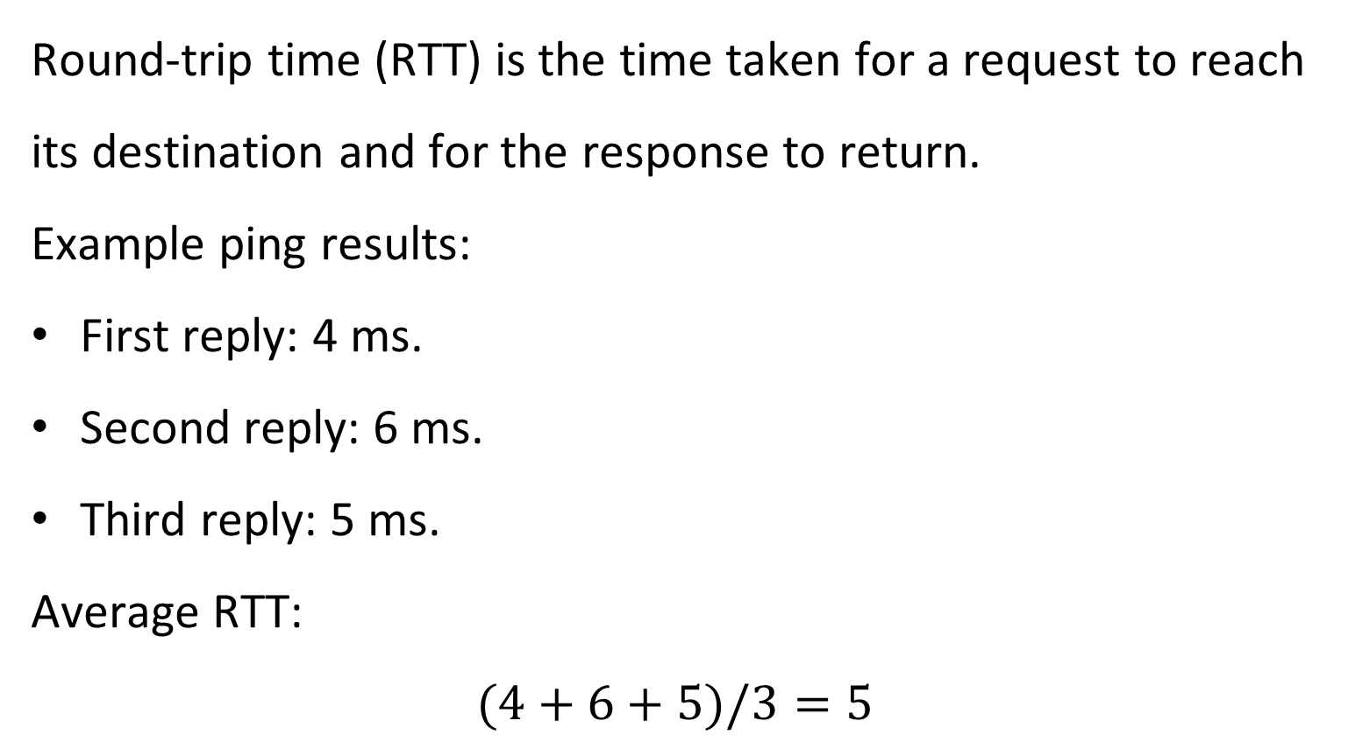
Measuring Round-Trip Time
Round-trip time (RTT) is the time taken for a request to reach its destination and for the response to return.
Example ping results:
First reply: 4 ms.
Second reply: 6 ms.
Third reply: 5 ms.
Average RTT:
$$(4+6+5)/3=5$$
3
Presentation_ID
© 2008 Cisco Systems, Inc. All rights reserved.

Slide 50
Measuring Round-Trip Time
Discussion: Does a lower RTT always mean that a network has higher bandwidth?
Answer: No. RTT measures delay, while bandwidth describes data-carrying capacity.
3
Presentation_ID
© 2008 Cisco Systems, Inc. All rights reserved.

Slide 51
Reading Router Hardware and Software Information
Use:
show version
Depending on the device and IOS output, this may show:
Cisco IOS version.
Router model.
System image.
Memory information.
Configuration register.
Hardware information.
3
Presentation_ID
© 2008 Cisco Systems, Inc. All rights reserved.

Slide 52
Reading Router Hardware and Software Information
The Scenario 1 task specifically asks students to identify the IOS version, NVRAM and ROM size for R2.
Discussion: Why should you report the values from R2 rather than another router?
Answer: Different devices may have different hardware, software and memory information.
3
Presentation_ID
© 2008 Cisco Systems, Inc. All rights reserved.

Slide 53
Reading Router Hardware and Software Information
The command show version displays important information about a Cisco router, including its IOS version, hardware and memory. Network administrators use this information when checking device specifications or troubleshooting software problems.
3
Presentation_ID
© 2008 Cisco Systems, Inc. All rights reserved.

Slide 54
Scenario 2: ABC Company Requirements
ABC Company has two departments.
Requirement | HR | Finance
PCs | 10 | 12
IP phones | 1 | 2
Wireless printers | 1 | 1
Scanners | 0 | 1
Current end devices | 12 | 16
3
Presentation_ID
© 2008 Cisco Systems, Inc. All rights reserved.

Slide 55
Scenario 2: ABC Company Requirements
Both departments require:
Internet connectivity through a shared ISP connection.
Capacity for future expansion.
Reliable communication.
Finance specifically requires secure and reliable systems.
Discussion: Why should Finance receive particular attention during network design?
Answer: It handles business information that may be sensitive and requires appropriate access controls, reliability and protection.
3
Presentation_ID
© 2008 Cisco Systems, Inc. All rights reserved.

Slide 56
Designing a Suitable Network Topology
A suitable design should consider:
Separate logical networks for HR and Finance.
Enough wired and wireless connectivity.
A router or Layer 3 device for inter-network communication.
A shared path towards the ISP.
Additional ports and address capacity for future growth.
Appropriate access controls between departments.
3
Presentation_ID
© 2008 Cisco Systems, Inc. All rights reserved.

Slide 57
Designing a Suitable Network Topology
Discussion: Why might separate VLANs be useful for HR and Finance?
Answer: VLANs create separate Layer 2 broadcast domains and can support more organised and controlled network access when combined with appropriate routing and security policies.
3
Presentation_ID
© 2008 Cisco Systems, Inc. All rights reserved.

Slide 58
Designing a Suitable Network Topology
This diagram shows a possible network design for ABC Company, with separate HR and Finance networks. Both departments connect through a shared router to access the Internet using one ISP connection.
3
Presentation_ID
© 2008 Cisco Systems, Inc. All rights reserved.

Slide 59
Configuring Router Interfaces
Illustrative Cisco IOS configuration:
enable
configure terminal
interface gigabitEthernet 0/0
description HR LAN
ip address 192.168.10.1 255.255.255.224
no shutdown
exit
Check using:
show ip interface brief
3
Presentation_ID
© 2008 Cisco Systems, Inc. All rights reserved.

Slide 60
Configuring Router Interfaces
Discussion: What happens if the router interface and HR computers use different, non-overlapping IP subnets?
Answer: The computers will not be able to use that interface as a directly reachable default gateway without correcting the addressing.
3
Presentation_ID
© 2008 Cisco Systems, Inc. All rights reserved.

Slide 61
Configuring Router Interfaces
Router interfaces need correct IP addresses and must be enabled before they can communicate. After configuring an interface, use show ip interface brief to check whether its status is up/up.
3
Presentation_ID
© 2008 Cisco Systems, Inc. All rights reserved.

Slide 62
Configuring End Devices and Default Gateways
Each end device needs appropriate settings:
IP address.
Subnet mask.
Default gateway.
DNS server, where name resolution is required.
3
Presentation_ID
© 2008 Cisco Systems, Inc. All rights reserved.

Slide 63
Configuring End Devices and Default Gateways
Example HR PC:
IP address: 192.168.10.10
Subnet mask: 255.255.255.224
Default gateway: 192.168.10.1
Discussion: A PC can ping another PC in the same subnet but cannot reach Finance. What should you check first?
Answer: The PC's default gateway and the routing between the two departmental networks.
3
Presentation_ID
© 2008 Cisco Systems, Inc. All rights reserved.

Slide 64
Remote Access: SSH and Telnet
Telnet provides remote command-line access but does not encrypt the session.
SSH encrypts remote management traffic.
SSH is preferred for secure administration.
Router and switch remote access should be restricted to authorised users.
3
Presentation_ID
© 2008 Cisco Systems, Inc. All rights reserved.

Slide 65
Remote Access: SSH and Telnet
Illustrative SSH configuration:
hostname HR-Router
ip domain-name abc.example
username admin privilege 15 secret ExampleOnly123!
crypto key generate rsa
ip ssh version 2
line vty 0 4
login local
transport input ssh
3
Presentation_ID
© 2008 Cisco Systems, Inc. All rights reserved.

Slide 66
Remote Access: SSH and Telnet
The example credentials are for classroom practice only and must not be reused as real passwords. RSA key generation may require a key-size selection, depending on IOS.
Discussion: Why is SSH generally safer than Telnet?
Answer: SSH encrypts the management session, reducing the risk of exposing credentials and commands.
3
Presentation_ID
© 2008 Cisco Systems, Inc. All rights reserved.

Slide 67
Remote Access: SSH and Telnet
SSH allows an authorised network administrator to connect securely to a router from another computer. Unlike Telnet, SSH encrypts the communication, helping protect usernames, passwords and commands.
3
Presentation_ID
© 2008 Cisco Systems, Inc. All rights reserved.

Slide 68
Connecting Both Departments to the Internet
A shared ISP connection requires an end-to-end design.
Consider:
Correct department IP addressing.
Appropriate routing between networks.
A default route towards the ISP.
NAT/PAT where private IPv4 addresses are used.
DNS and any required ISP-side settings.
Appropriate security rules.
3
Presentation_ID
© 2008 Cisco Systems, Inc. All rights reserved.

Slide 69
Connecting Both Departments to the Internet
Discussion: Why might two private departmental networks need NAT/PAT to access the public Internet?
Answer: Private IPv4 addresses are not globally routed on the public Internet. NAT/PAT can translate internal addresses to a suitable public address.
3
Presentation_ID
© 2008 Cisco Systems, Inc. All rights reserved.

Slide 70
Connecting Both Departments to the Internet
NAT/PAT allows multiple computers with private IP addresses to access the Internet through a shared public IP address. In this example, both HR and Finance can use the same Internet connection without requiring a separate public IP address for every computer.
3
Presentation_ID
© 2008 Cisco Systems, Inc. All rights reserved.

Slide 71
Network Testing and Evidence
Test the network systematically:
Check interface status.
Verify device IP addresses.
Ping the local default gateway.
Test communication between authorised departments.
Test access towards the simulated ISP.
Test SSH remote access.
Verify routes and save configurations.
3
Presentation_ID
© 2008 Cisco Systems, Inc. All rights reserved.

Slide 72
Network Testing and Evidence
Useful commands:
show ip interface brief
show ip route
ping <destination-IP>
traceroute <destination-IP>
show running-config
copy running-config startup-config
3
Presentation_ID
© 2008 Cisco Systems, Inc. All rights reserved.

Slide 73
Network Testing and Evidence
Discussion: Why should screenshots show actual command results rather than just the topology?
Answer: A topology shows the intended connections, while command outputs provide evidence that the configuration and tests were performed.
3
Presentation_ID
© 2008 Cisco Systems, Inc. All rights reserved.

Slide 74
What to Do and What to Avoid
What to do
Read both scenarios carefully.
Keep a record of original faults.
Test one correction at a time.
Use accurate subnet masks and gateways.
Configure the required security controls.
Save configurations and Packet Tracer files.
Provide genuine screenshots and command evidence.
Explain your design decisions.
3
Presentation_ID
© 2008 Cisco Systems, Inc. All rights reserved.

Slide 75
What to Do and What to Avoid
What to avoid
Guessing fault causes without evidence.
Changing unrelated configurations.
Reusing a previous ticket's solution.
Assigning overlapping IP subnets.
Assuming an ISP connection works without testing.
Using Telnet as the preferred secure management method.
Submitting screenshots that do not match the final files.
Copying another student's work.
3
Presentation_ID
© 2008 Cisco Systems, Inc. All rights reserved.

Slide 76
What to Do and What to Avoid
Discussion: Why should you save a copy of the original troubleshooting file?
Answer: It allows you to compare the original and corrected network and recover if an incorrect change causes additional problems.
3
Presentation_ID
© 2008 Cisco Systems, Inc. All rights reserved.

Slide 77
Submission Checklist
Completed all four Scenario 1 tickets
Answered the route and RTT questions
Recorded diagnostic commands, findings and corrective commands
Completed the Scenario 2 network design
Included the required HR and Finance devices
Checked subnet masks, IP addresses and gateways
Configured and tested the required routing and remote-access services
3
Presentation_ID
© 2008 Cisco Systems, Inc. All rights reserved.

Slide 78
Submission Checklist
Renamed one router with my first name, one with my last name and one switch with my student ID
Saved and reopened both Packet Tracer files
Prepared the technical report with screenshots and command evidence
Explained design decisions, security, scalability and sustainability
Prepared the required seven-minute presentation with face overlay
Checked the online viva arrangements
Reviewed the Canvas rubric and submission deadline
3
Presentation_ID
© 2008 Cisco Systems, Inc. All rights reserved.

Slide 79
Submission Checklist
Submission reminder: Based on the A3 guide, the required artefacts include the two .pkt files, technical report PDF, configuration evidence and presentation.
3
Presentation_ID
© 2008 Cisco Systems, Inc. All rights reserved.

Slide 80
Final Revision: Think Like a Network Engineer
Before your viva, be ready to answer:
What problem did you identify?
Which command helped you find it?
Why did you select that command?
What did you change?
How did you verify the correction?
Why did you select your network design?
How did you improve security and scalability?
What would you do differently in a real workplace?
3
Presentation_ID
© 2008 Cisco Systems, Inc. All rights reserved.

Slide 81
Final Revision: Think Like a Network Engineer
Discussion: What is the difference between memorising Cisco commands and understanding networking?
Answer: Memorising helps you recall commands. Understanding helps you select the right command, interpret the result, identify the problem and explain the solution.
3
Presentation_ID
© 2008 Cisco Systems, Inc. All rights reserved.

Slide 82
Additional Notes about Assessment 3
Students must submit the following:
Scenario 1 – Completed Cisco Packet Tracer .pkt file.
Scenario 2 – Completed Cisco Packet Tracer .pkt file.
Technical Design and Troubleshooting Report in PDF format.
Seven-minute recorded presentation with face overlay, or attend the scheduled live presentation as instructed.
Attend the compulsory online viva at the allocated time.
3
Presentation_ID
© 2008 Cisco Systems, Inc. All rights reserved.

Slide 83
Additional Notes about Assessment 3
Important reminders:
Submit files individually through Canvas.
Do not submit ZIP or RAR files unless specifically instructed.
Ensure both Packet Tracer files open correctly.
Check that the report and presentation match the final configurations.
3
Presentation_ID
© 2008 Cisco Systems, Inc. All rights reserved.

Slide 84
Additional Notes about Assessment 3
Discussion question: Can students submit only the PDF report and screenshots without their Packet Tracer files?
Answer: No. Both completed .pkt files are compulsory.
3
Presentation_ID
© 2008 Cisco Systems, Inc. All rights reserved.

Slide 85
Additional Notes about Assessment 3
How to Prepare Your Technical Report
Recommended report structure:
Student details and assessment overview.
Scenario 1 – Troubleshooting tickets, identified problems, diagnostic commands and corrections.
Scenario 1 – Route identification and RTT calculations.
Scenario 2 – Proposed network topology and addressing plan.
Scenario 2 – Device configurations, security and remote access.
Connectivity testing, screenshots and command outputs.
Technical explanations, design justification, scalability and sustainability.
Conclusion, references where applicable, and AI-use statement.
3
Presentation_ID
© 2008 Cisco Systems, Inc. All rights reserved.

Slide 86
Additional Notes about Assessment 3
Important: Screenshots should be readable, clearly labelled and consistent with the submitted Packet Tracer files.
Discussion question: Why should the report include both diagnostic commands and their outputs?
Answer: The commands explain how the network was investigated, while the outputs provide evidence supporting the findings.
3
Presentation_ID
© 2008 Cisco Systems, Inc. All rights reserved.

Slide 87
Additional Notes about Assessment 3
Preparing Your Seven-Minute Presentation
Suggested presentation structure:
Section | Time
Introduction and assessment objectives | 30 seconds
Scenario 1 – Troubleshooting approach and results | 2 minutes
Scenario 2 – Network design and addressing | 1.5 minutes
Configuration, security and connectivity testing | 2 minutes
Conclusion and key learning outcomes | 1 minute
Total | 7 minutes
3
Presentation_ID
© 2008 Cisco Systems, Inc. All rights reserved.

Slide 88
Additional Notes about Assessment 3
Presentation requirements:
Explain the work in your own words.
Show the relevant Packet Tracer topology and evidence.
Explain important decisions rather than reading every configuration command.
Use a clear voice and professional language.
Include the required face overlay for a recorded presentation.
3
Presentation_ID
© 2008 Cisco Systems, Inc. All rights reserved.

Slide 89
Additional Notes about Assessment 3
Discussion question: Should students spend most of their presentation reading Cisco commands?
Answer: No. They should focus on what they implemented, why they selected that approach and how they verified that it worked.
3
Presentation_ID
© 2008 Cisco Systems, Inc. All rights reserved.

Slide 90
Additional Notes about Assessment 3
Academic Integrity and Responsible AI Use
Permitted AI support, subject to Canvas instructions:
Understanding networking concepts.
Brainstorming high-level design considerations.
Improving grammar and report clarity.
Identifying areas where explanations need improvement.
3
Presentation_ID
© 2008 Cisco Systems, Inc. All rights reserved.

Slide 91
Additional Notes about Assessment 3
Not permitted:
Using AI to generate the final network design.
Using AI to complete troubleshooting tickets.
Submitting AI-generated configuration commands as your own work.
Generating substantial report or presentation content.
Fabricating screenshots, command outputs or testing results.
Students must include a brief AI-use statement in the report, including any additional disclosure required by the assessment instructions.
3
Presentation_ID
© 2008 Cisco Systems, Inc. All rights reserved.

Slide 92
Additional Notes about Assessment 3
Discussion question: Can a student use AI to generate all the configuration commands and submit them without understanding them?
Answer: No. The guide prohibits AI-generated configuration commands for submission. Students must complete their own technical work and explain it during the viva.
3
Presentation_ID
© 2008 Cisco Systems, Inc. All rights reserved.

Slide 93
Additional Notes about Assessment 3
Final Preparation for the Online Viva
During the compulsory viva, students may be asked to:
Open their submitted Packet Tracer files.
Explain how they identified a network fault.
Demonstrate a relevant Cisco IOS command.
Explain why a particular subnet or gateway was selected.
Justify security and remote-access configurations.
Interpret ping, traceroute or routing results.
Explain how their network supports future growth.
Demonstrate that they understand their own report and presentation.
3
Presentation_ID
© 2008 Cisco Systems, Inc. All rights reserved.

Slide 94
Additional Notes about Assessment 3
Discussion question: What should you do if the lecturer asks why you selected a particular network configuration?
Answer: Explain the technical reason, relate it to the network requirements and show relevant evidence from your submitted work.
3
Presentation_ID
© 2008 Cisco Systems, Inc. All rights reserved.

Slide 95

Let’s Answer Your Questions
Canvas Inbox – For academic queries.
Email – For formal communication and attachments.
Canvas Discussion – For academic discussions and general queries.
Reminder – Please follow up if you do not receive a response within 3 business days.

Slide 96

Happy Learning and Bright Futures Ahead!
Dr. Farshid Keivanian
Stay Connected:
linkedin.com/in/farshid-keivanian
github.com/FarshidKeivanian
Education is the most powerful weapon you can use to change the world. — Nelson Mandela

